Slide 1
GCBASIC
PIC16F175xx
Part 15 – Millis and Interrupts

Slide 2

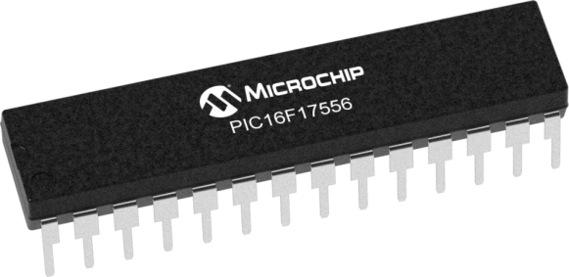
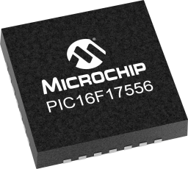
GCBASIC
PIC16F175xx
Part 15 – Millis and Interrupts

Slide 3
GCBASIC
Like and subscribe!

Slide 4
PIC16F175xx
PIC16175xx is a high performance PIC16
Digital and analog peripherals for flexible embedded control
10-bit ADC for accurate analog signal conversion
Multiple communication interfaces including UART (serial), I²C, and SPI
PWM modules with CCP and 16-bit resolution for precise timing and motor control
Configurable Logic Cells (CLCs) for custom hardware-level logic without external components
Integrated op amps for onboard analog signal conditioning and amplification
The PIC16175xx offers 14, 20, 28, 40 and 44-pin products in small footprint packages to support customers in a wide variety of applications.

Slide 5
Videos...
Install the hardware and make the board work – three LED programs
Make four LEDs flash in a sequence
Set the LEDs to represent the value of ADC
Sequence the LEDs with a delay using the value of ADC
Using an input to set the state of the LEDs
Using the reset switch
Using the switch, ADC – make the LEDs flash in a sequence with reverse
Using the serial to display values
Using the timer0 overflow, 8bit timer, 16bit timer to flash the LEDs
Using EEProm – showing values on the serial terminal, and more constants insights
Using I2C with serial to discover I2C devices
Using I2C GCLD display solutions
Using a SPI GLCD display solutions
Using PWM, 6 ways, to dim the LEDS
Using Millis and Interrupts
Using storage within the chip – Progmem, SAF memory, EEPROM and DATA blocks
Using CLC
The GCBASIC tool chain
Assembly , alternatives assemblers and MPLAB-X
Summary

Slide 6
GCBASIC Compiler
GCBASIC Compiler
GCBASIC is an Open Source compiler for PIC, AVR and LGT microcontrollers
GCBASIC now supports the 16F175xx chip family

Slide 7
Prerequisites
Assumes you have
Installed the GCBASIC software
Installed your programmer software
Test that you have the 16F175xx attached
Switch attached
You have the 4 LEDs operating

Slide 8
Hardware
Hardware // -------------------PORTA----------------
// Bit#: -7---6---5---4---3---2---1---0---
// IO: ------------------SW----------ADC-
// ----------------------------------
// -------------------PORTB----------------
// Bit#: -7---6---5---4---3---2---1---0---
// IO: ---------------------------------
// ---------------------------------
// ------------------PORTC-----------------
// Bit#: -7---6---5---4---3---2---1---0---
// IO: ----------------LED-LED-LED-LED--
// ---------------------------------
//
// ------------------PORTE-----------------
// Bit#: -7---6---5---4---3---2---1---0---
// IO: ----------------MCLR-------------
// -----------------SW--------------
Prototype Board
Power 5v0
Programmer
Switch
LEDs & resistors

Slide 9
Millis()
Returns milliseconds since program start/reset
like Arduino's timing for GCBASIC
Key Benefit
Non-blocking delays for multitasking
no code halts
unlike DelayMS
Return Type
32-bit unsigned long (0–4.3B ms)
1ms precision via timers
Time Limit
~49.7 days before overflow
Resets on power cycle.

Slide 10
Lab
Walk the example

Slide 11
Principles of Interrupts
Interrupts are events that alter the normal execution flow of a program to respond to external or internal events.
Advantages
Immediate response to critical events
Efficient use of the microcontroller's resources
Types of Interrupts
External Interrupts: Triggered by events on external pins (RB0/INT0, RB1/INT1, etc.)
Timer Interrupts: Triggered by timer overflows or matches
Peripheral Interrupts: Triggered by events from peripherals (USART, ADC, etc.)
Software Interrupts: Triggered by software instructions
Key Registers
INTCON: Controls global interrupt enable and individual interrupt flags
PIE1, PIE2: Peripheral Interrupt Enable registers
PIR1, PIR2: Peripheral Interrupt Request (flag) registers
Interrupt Service Routine (ISR)
Special function that executes when an interrupt occurs
Must be as short and efficient as possible to avoid delaying other operations

Slide 12
Interrupts…
For specific details of the interrupts see the microcontroller datasheet
The first parameter is the GCBASIC identifier used in user code to expose the specific interrupt
1. ADCReady:ADIE,ADIF
2. ADThreshold:ADTIE,ADTIF
3. ActiveClockTuning:ACTIE,ACTIF
4. CCP1:CCP1IE,CCP1IF
5. CCP2:CCP2IE,CCP2IF
6. CRCComplete:CRCIE,CRCIF
7. CWG1ShutDown:CWG1IE,CWG1IF
8. ClockSwitchComplete:CSWIE,CSWIF
9. Comp1Change:CM1IE,CM1IF
10. ExtInt0:INTE,INTF
11. LogicCell1Event:CLC1IE,CLC1IF
12. LogicCell2Event:CLC2IE,CLC2IF
13. LogicCell3Event:CLC3IE,CLC3IF
14. LogicCell4Event:CLC4IE,CLC4IF
15. LowPowerComparator:CMLP1IE,CMLP1IF
16. NVMComplete:NVMIE,NVMIF
17. NumericOscOverflow:NCO1IE,NCO1IF
18. OPA1SelfCalibration:OPA1CIE,OPA1CIF
19. OPA2SelfCalibration:OPA2CIE,OPA2CIF
20. OPA3SelfCalibration:OPA3CIE,OPA3CIF
21. OscillatorFail:OSFIE,OSFIF
22. PORTABChange:IOCIE,IOCIF
23. PWM1MatchEvent:PWM1IE,PWM1IF
24. PWM2MatchEvent:PWM2IE,PWM2IF
25. PWM2PeriodEvent:PWM2PIE,PWM2PIF
26. PWMPeriodEvent:PWM1PIE,PWM1PIF
27. PortChange:IOCIE,IOCIF
28. SSP1Collision:BCL1IE,BCL1IF
29. SSP1Ready:SSP1IE,SSP1IF
30. SSP2Collision:BCL2IE,BCL2IF
31. SSP2Ready:SSP2IE,SSP2IF
32. ScanComplete:SCANIE,SCANIF
33. SignalRoutingPortIOC:IOCSRIE,IOCSRIF
34. Timer0Overflow:TMR0IE,TMR0IF
35. Timer1Gate:TMR1GIE,TMR1GIF
36. Timer1Overflow:TMR1IE,TMR1IF
37. Timer2Match:TMR2IE,TMR2IF
38. Timer3Gate:TMR3GIE,TMR3GIF
39. Timer3Overflow:TMR3IE,TMR3IF
40. Timer4Match:TMR4IE,TMR4IF
41. Timer6Match:TMR6IE,TMR6IF
42. UsartRX1Ready:RC1IE,RC1IF
43. UsartRX2Ready:RC2IE,RC2IF
44. UsartTX1Ready:TX1IE,TX1IF
45. UsartTX2Ready:TX2IE,TX2IF
46. ZeroCrossDetect:ZCDIE,ZCDIF

Slide 13
Interrupt on Change (IOC)
Detects changes in the state of selected pins
Key Points
Configuration: Set IO port.pin as inputs and configure the correct register for edge detection (rising or falling edge)
Interrupt Service Routine (ISR)
Handles the interrupt event
Global Interrupt Enable (GIE)
Enables the microcontroller to respond to interrupts

Slide 14
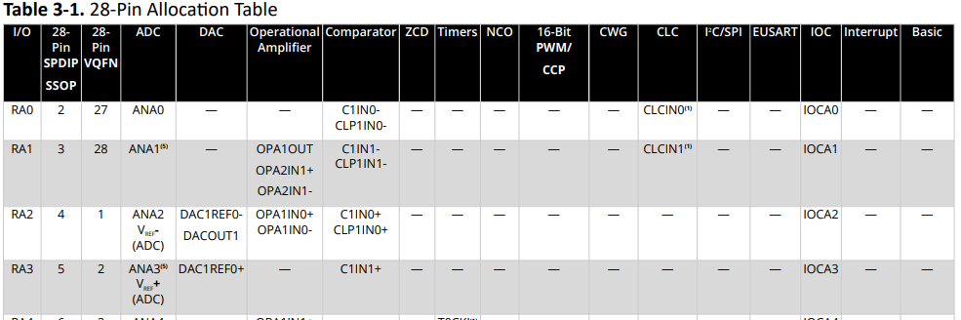
Interrupt - IOC

Slide 15
Interrupt Code
……
//IO ports setup
/* Interrupt-on-change enabled on the IOCx pin for a negative-going edge. Associated Status bit
and interrupt flag will be set upon detecting an edge. */
IOCAN3 = 1
//Sets up GIE, create handler for interrupt
On Interrupt PORTChange Call InterruptHandler
Do lots of code
If SWPressed Then
RC3 = SWState
SWPressed = False
End If
Loop
Sub InterruptHandler
Dim SWState,SWPressed as BIT
If SWState <> SWITCHIN AND SWPressed = False Then
wait 10 us
'Save the switch state
SWState = SWITCHIN
'Inform main loop of interrupt
SWPressed = True
End If
'We must clear this specific bit flag in software, the main IOC is cleare by the GCBASIC interrupt handler
IOCAF3 = 0
End Sub

Slide 16
Lab
Walk the example
View the scope

Slide 18
Videos...
Install the hardware and make the board work – three LED programs
Make four LEDs flash in a sequence
Set the LEDs to represent the value of ADC
Sequence the LEDs with a delay using the value of ADC
Using an input to set the state of the LEDs
Using the reset switch
Using the switch, ADC – make the LEDs flash in a sequence with reverse
Using the serial to display values
Using the timer0 overflow, 8bit timer, 16bit timer to flash the LEDs
Using EEProm – showing values on the serial terminal, and more constants insights
Using I2C with serial to discover I2C devices
Using I2C GCLD display solutions
Using a SPI GLCD display solutions
Using PWM, 6 ways, to dim the LEDS
Using Millis and Interrupts
Using storage within the chip – Progmem, SAF memory, EEPROM and DATA blocks
Using CLC
The GCBASIC tool chain
Assembly , alternatives assemblers and MPLAB-X
Summary

Slide 19
GCBASIC
PIC16F175xx
Part 15 – Millis and Interrupts

